Slide 1
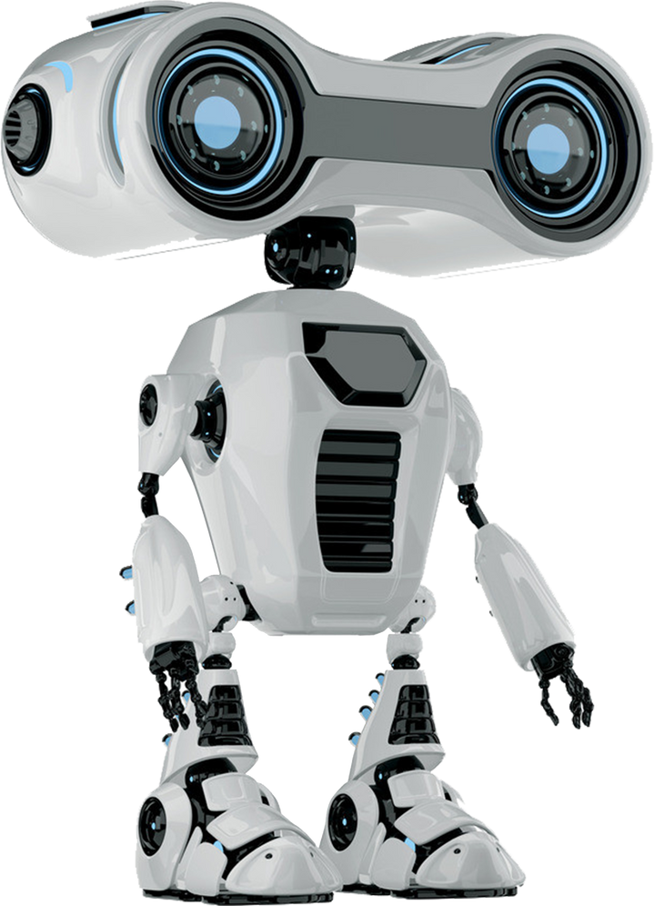
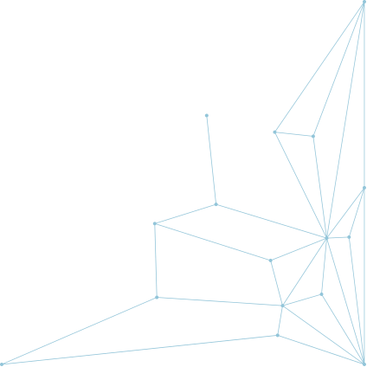
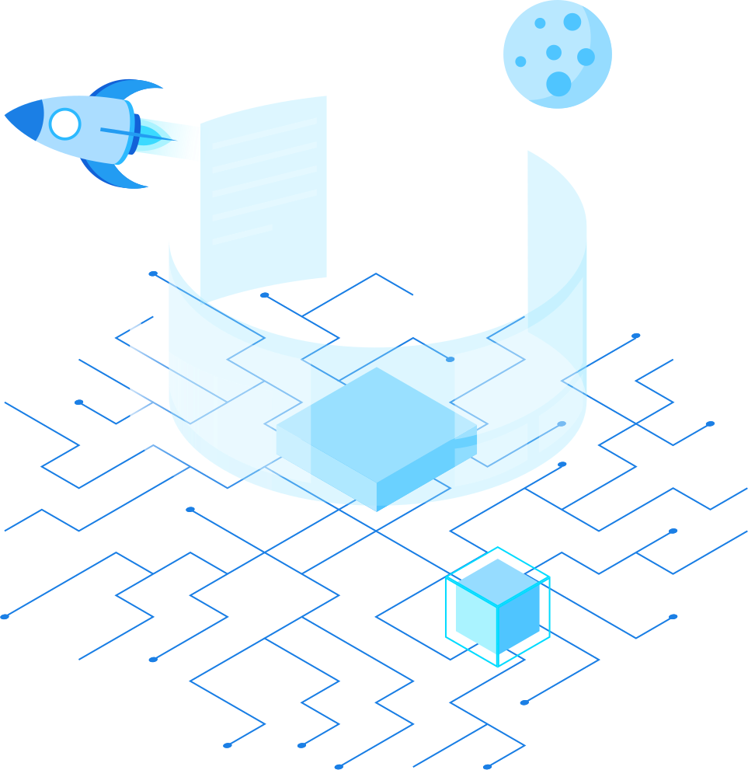

WELCOME

Slide 2
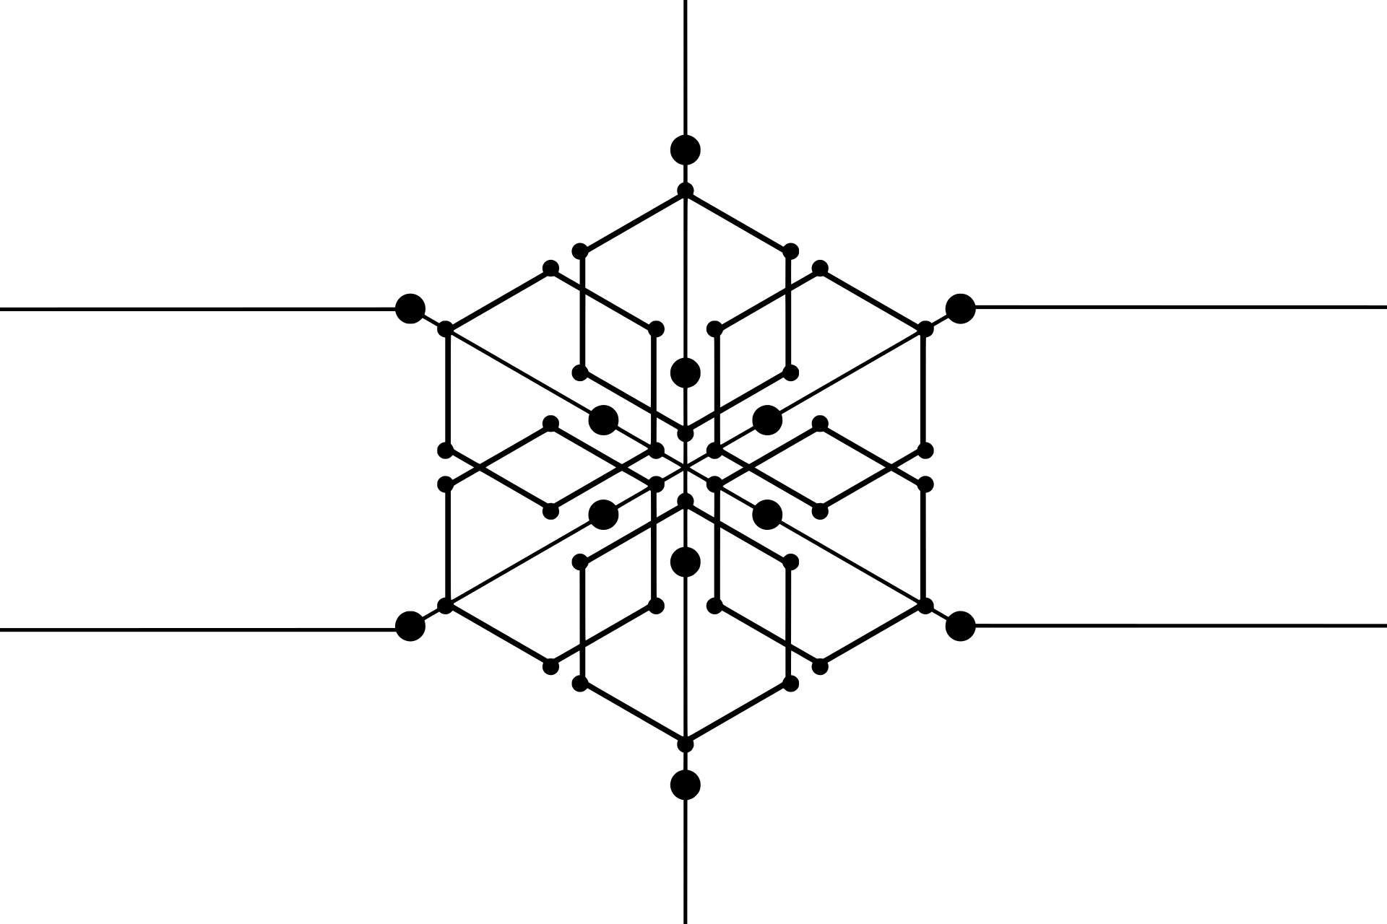
IOT-BASED PATIENT HEALTH MONITORING SYSTEM
PRESENTED BY :
SHARIFUL ISLAM (SAJIB) SARKER ID 2125051016
KAMRUN NAHAR MITU ID 2125051019

Slide 3



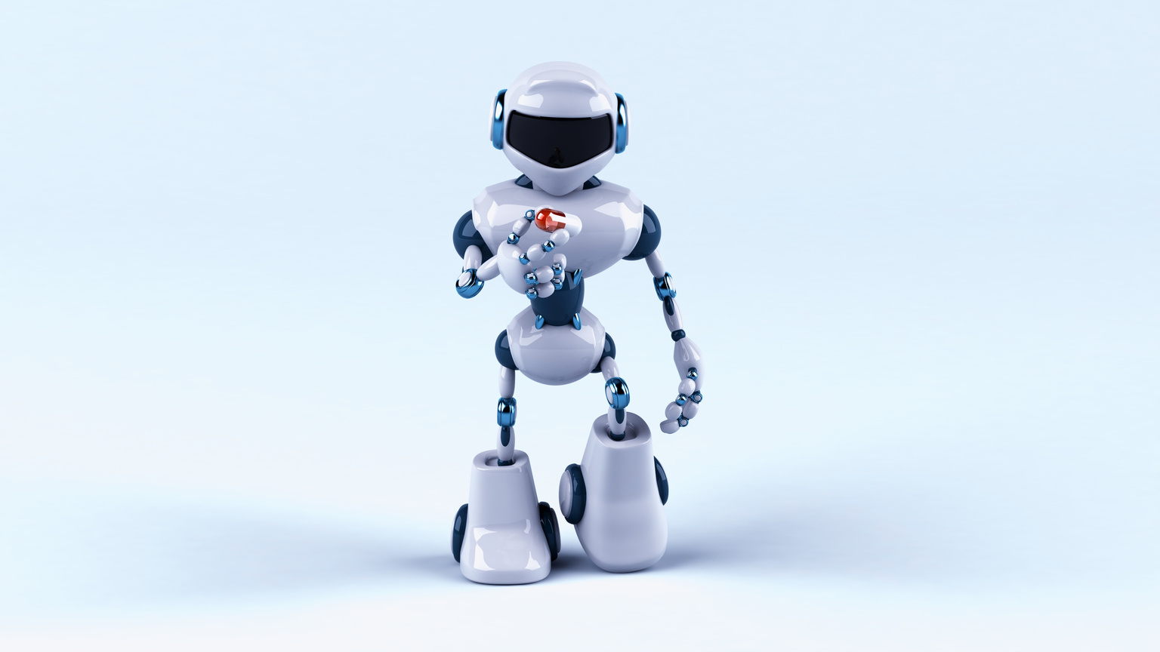

INTRODUCTION
The Patient Health Monitoring System is an IoT-based project aimed at improving healthcare efficiency by remotely monitoring patients' vital signs in real-time. This system offers a non-invasive and continuous method of tracking patient health parameters like heart rate, blood pressure, temperature, and oxygen levels, ensuring timely medical intervention.

Slide 4
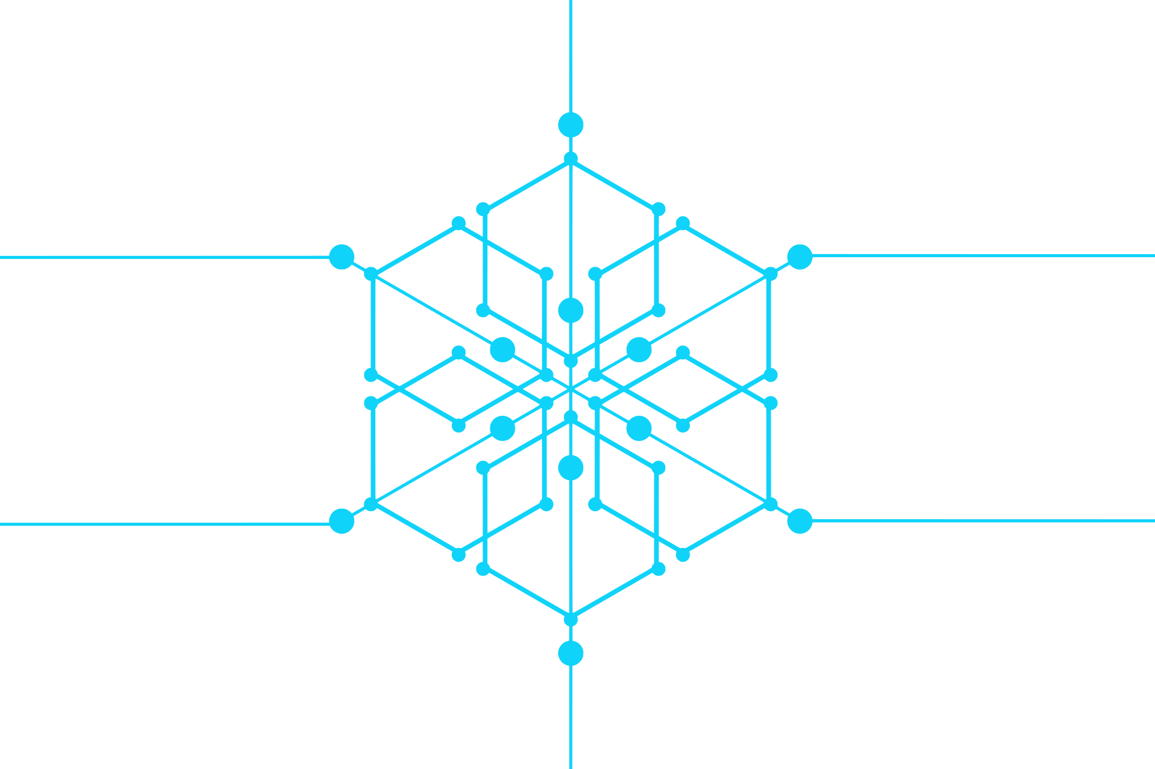



Problem Identification
Traditional patient monitoring uses occasional checks, which can delay finding serious health problems.
This is especially risky for patients with long-term illnesses or those recovering from surgery.
Without constant monitoring, healthcare workers find it harder to manage resources well.
Delays in care can lead to more hospital visits and higher healthcare costs.

Slide 5

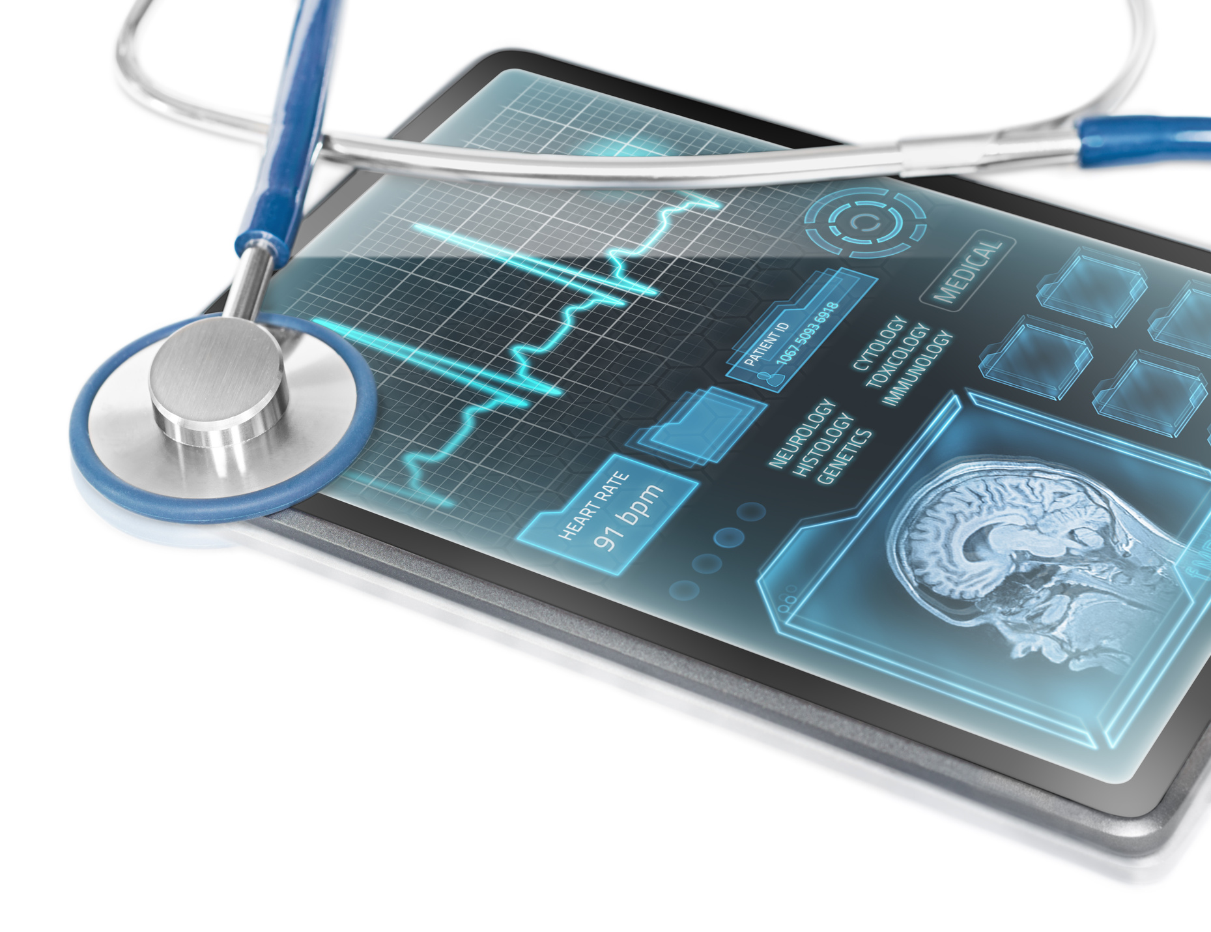
Our Technology Solutions
Your paragrMonitor heart rate, blood pressure, oxygen saturation, and body temperature.aph text
Transmit data to a cloud-based platform for real-time analysis by healthcare professionals.
Generate alerts for any abnormal readings, allowing for immediate intervention.
Provide patients with access to their health data via a mobile application, promoting proactive health management.

Slide 6
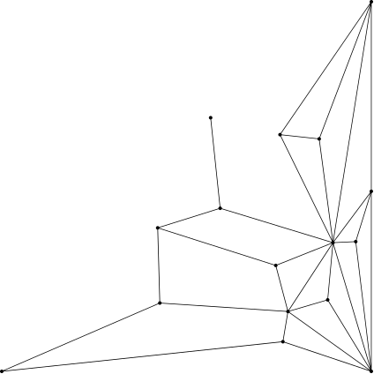
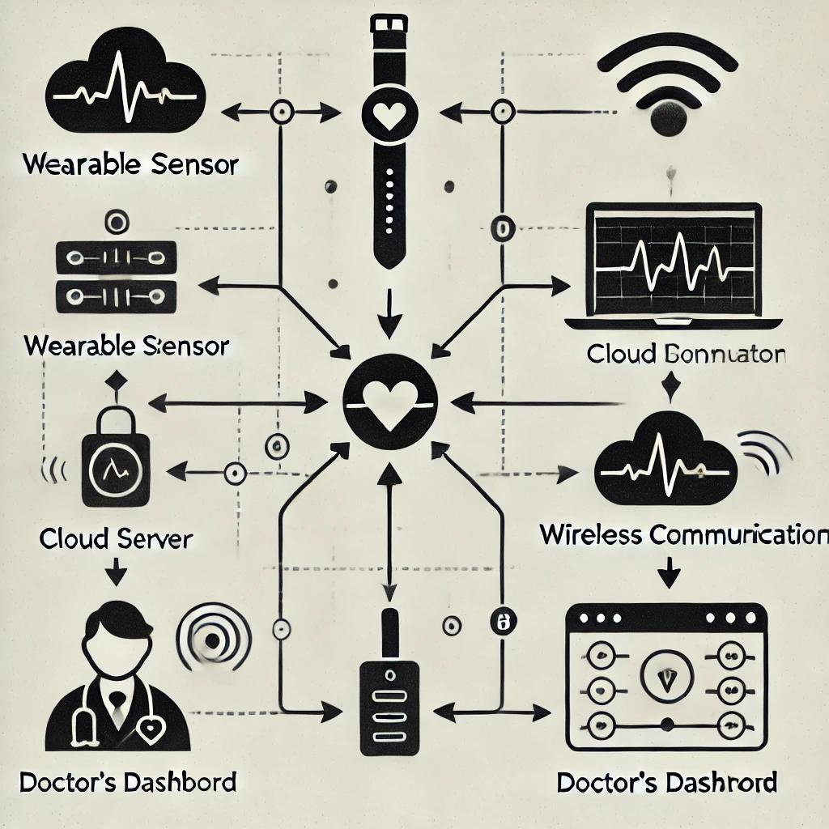
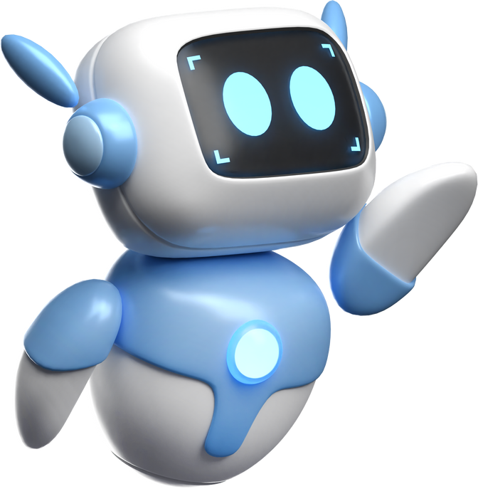
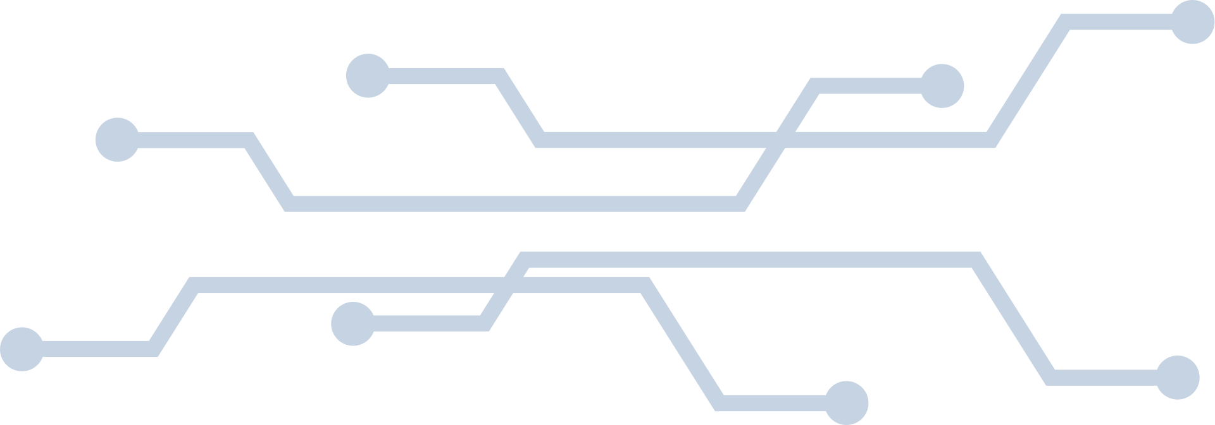
Virtual Diagram

Slide 7
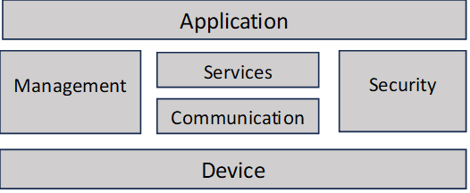
Logical Design

Slide 8
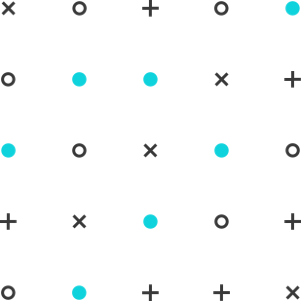
Preliminary Timeline
01
02
03
MONTH 1
MONTH 2-4
MONTH 5-7
Planning
Design and Prototype
Development

Slide 9


Conclusion
In conclusion, our Patient Health Monitoring System offers a scalable, affordable, and effective solution to address the growing challenges of continuous patient care. By leveraging IoT technology, we can ensure better health outcomes, more efficient healthcare delivery, and increased accessibility, particularly for remote or elderly patients.

Slide 10
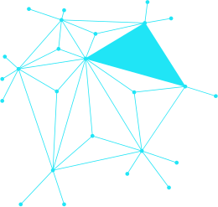

Reference
1. IOT_logical and physical design pdf (google classroom)
2. chatgtp
3. Nevon projects IOT Projects Ideas

Slide 11

THANK YOU!

Slide 12
Any Question

